Slide 1

Tezpur University
Topic- Online Used book store
Presented by-
Hari om jee
MCA 2nd sem.
CSM20010

Slide 2
Introduction-
Purpose
This system will help the users to know automatically when certain book requested by them has arrived once they have registered with the website. It will also help the users to know the latest books of their interests being introduced into the market like fiction, science, technology etc.
Scope
1. There are three basic users – Anonymous, Registered Members(customers), Administrator.
2. The customer, through the process of account creation, will have the option to become a member of the site.
3. The system will allow customers to browse, search, select, and add books to a shopping cart.
4. Admin has the authority to add/delete users, grant permission to members and users to purchase book.

Slide 3
Overview
Existing System:
Manually Registration
Drawbacks:
No webcam support
Not all users can have access to website
People who doesn’t have a knowledge of computer and internet cannot use the system
Proposed System:
Registration for users(customers)
Sale of books with email intimation.
Notification through mobile message when new books arrive.
Our Plan:
Registration for members.
Online maintenance of books and sales.
Acknowledgment for registration, sales and arrival of new books through Emil.
Feedback from user

Slide 4
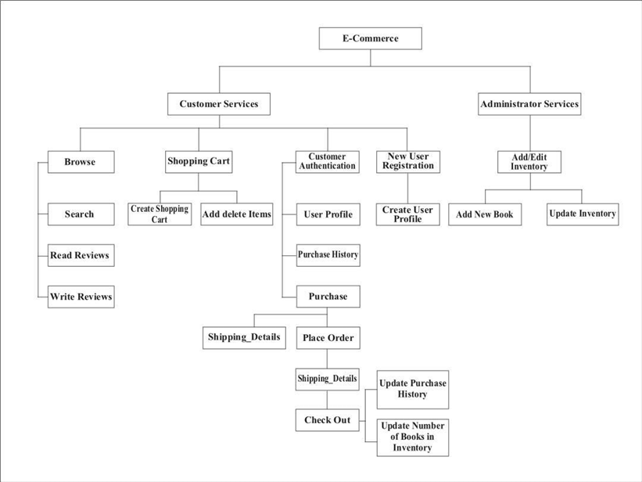
User case Diagram

Slide 5
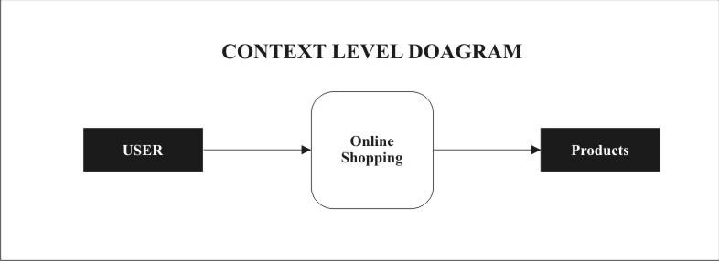
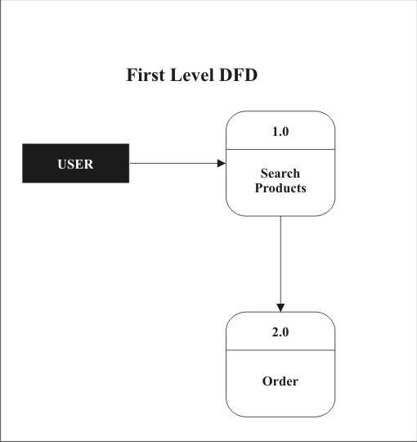
DFD(Data Flow Diagram)

Slide 6
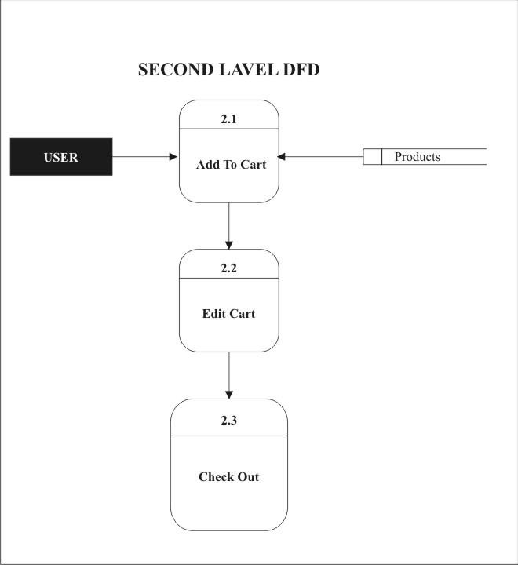

Slide 7
Data Dictionary
books
Column | Type | Null | Default | Links to | Comments | Media type
id (Primary) | int(30) | No
category_ids | text | No
title | varchar(200) | No
author | text | No
description | text | No
qty | int(11) | No
price | float | No
image_path | text | No
date_created | datetime | No | current_timestamp()
cart
Column | Type | Null | Default | Links to | Comments | Media type
id (Primary) | int(30) | No
book_id | int(30) | No
qty | int(30) | No
price | float | No
customer_id | int(30) | No

Slide 8
customers
Column | Type | Null | Default | Links to | Comments | Media type
id (Primary) | int(30) | No
name | text | No
address | text | No
contact | varchar(100) | No
email | varchar(150) | No
password | text | No
date_created | datetime | No | current_timestamp()
orders
Column | Type | Null | Default | Links to | Comments | Media type
id (Primary) | int(30) | No
customer_id | int(30) | No
address | text | No
total_amount | float | No
status | tinyint(1) | No | 0
date_created | datetime | No | current_timestamp()

Slide 9
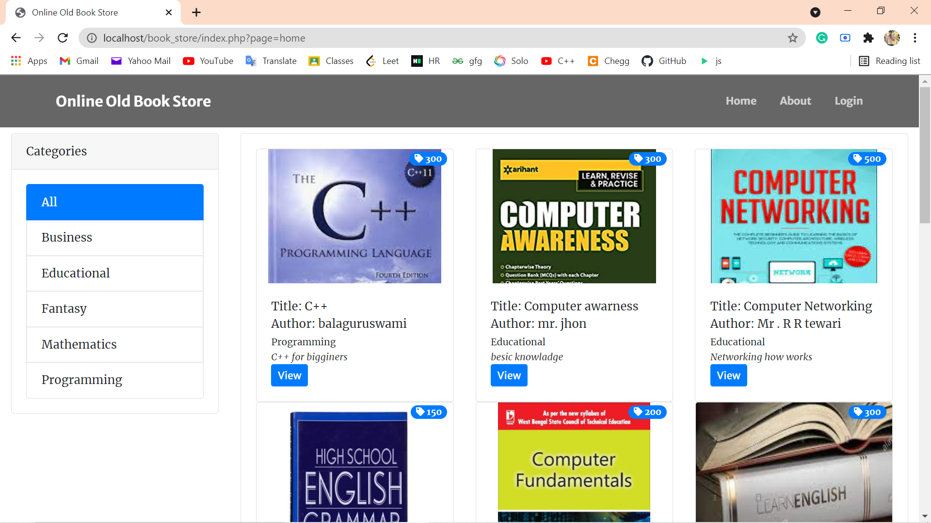
Snapshots

Slide 10
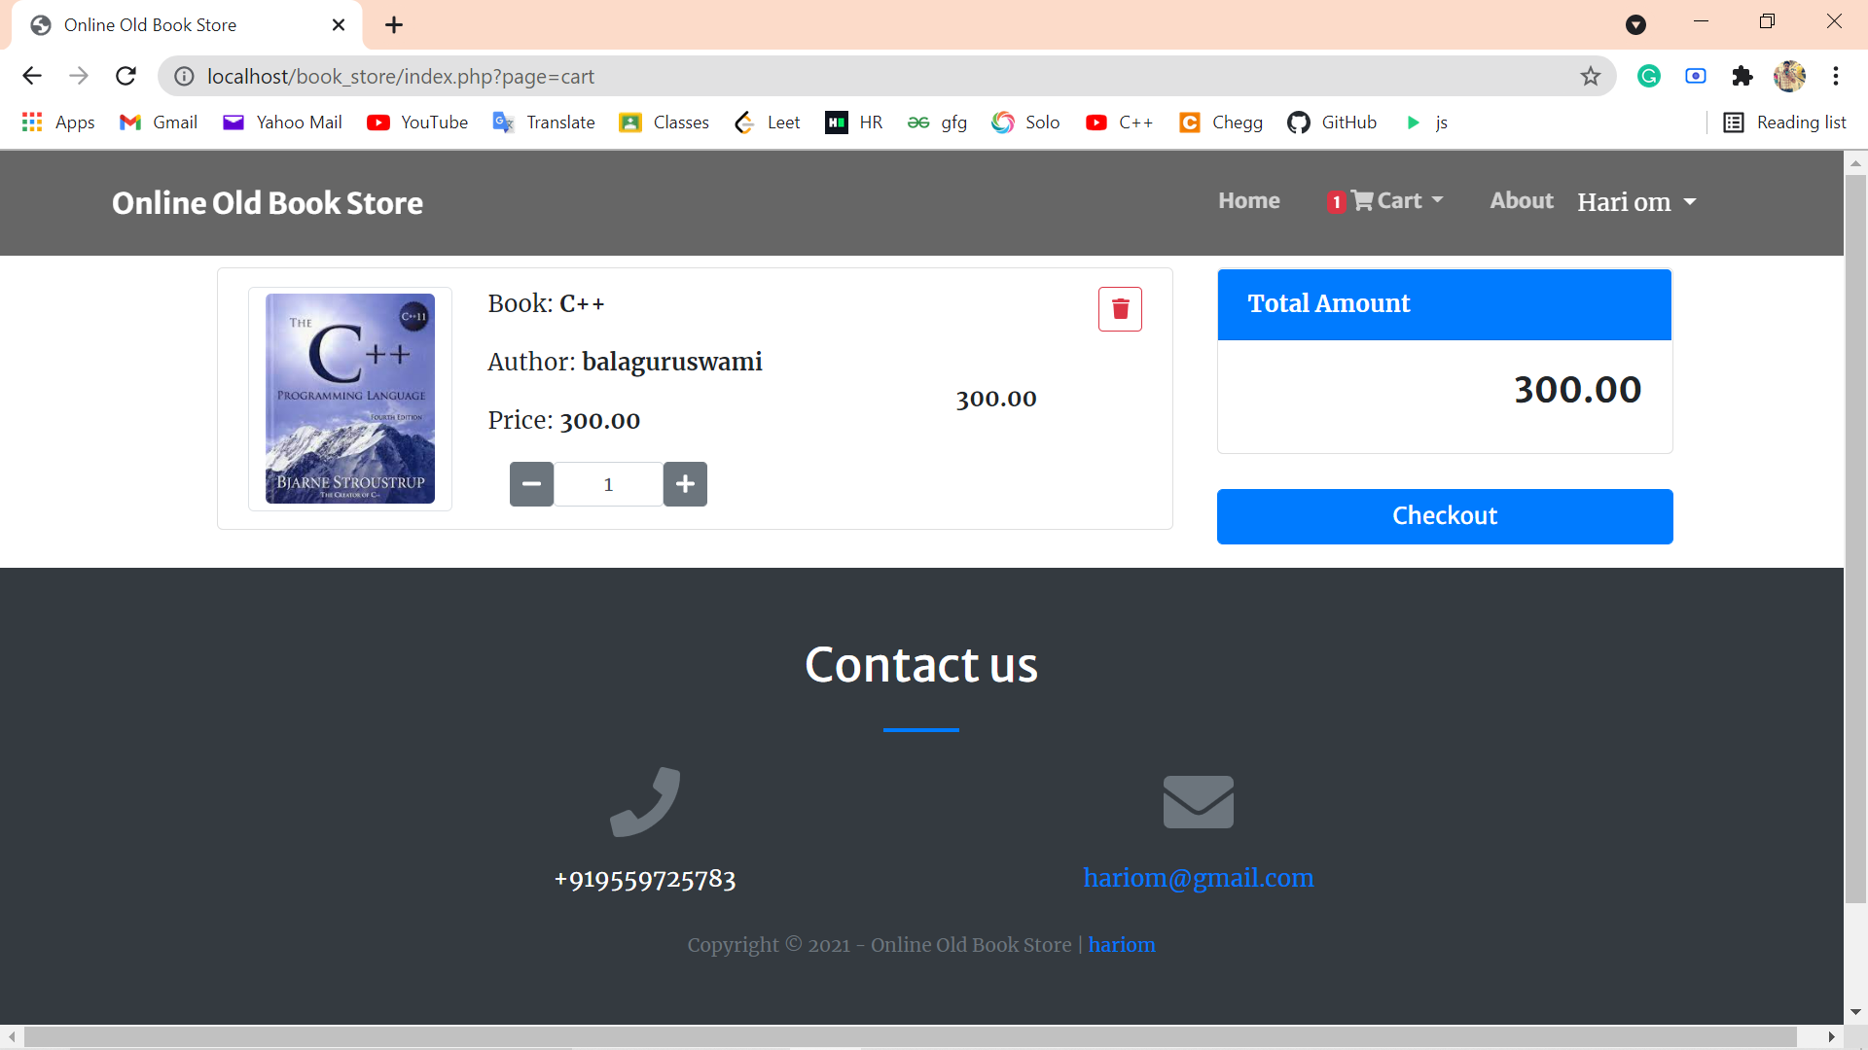

Slide 11
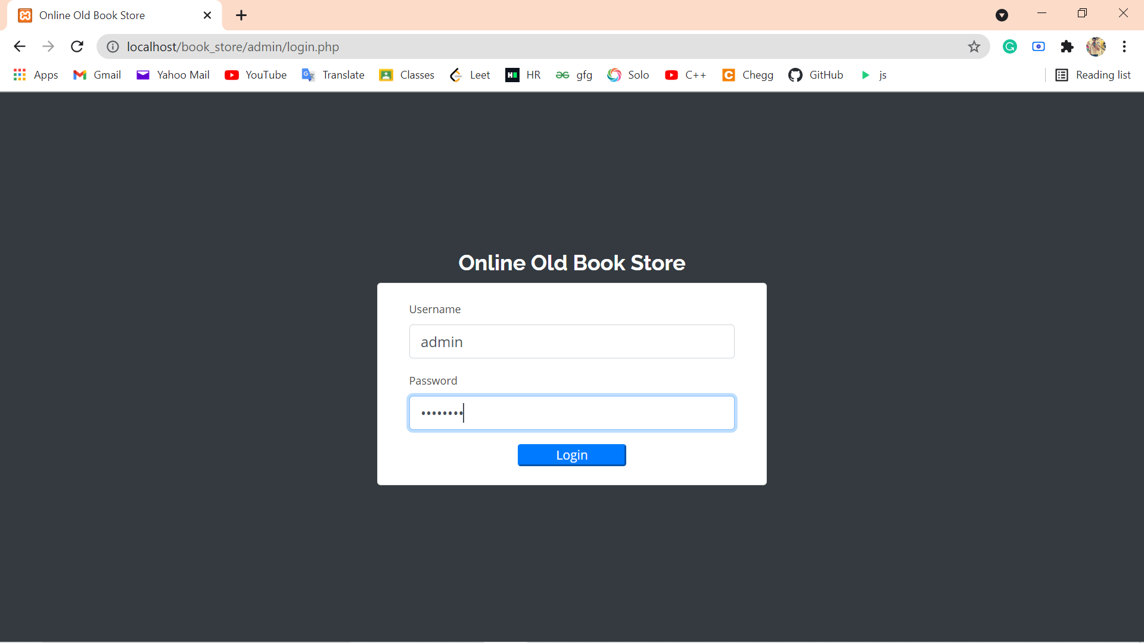

Slide 12
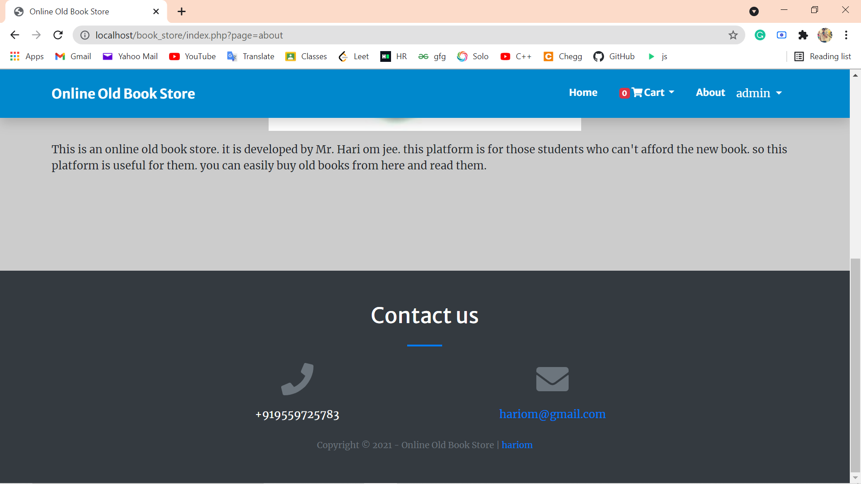

Slide 13
Thank you ….!!

